Slide 1
Sewer, Sidewalks, and Streets Committee Meeting
Location: City Hall – 30425 Lakeshore Blvd, Willowick, Ohio
Date: July 15, 2025
Time: 17:30 EST

Slide 2
Agenda
June 27, 2025 Wet weather Event
Master Plan review
Funding Options

Slide 3
June 27, 2025 Wet Weather Event

Slide 4
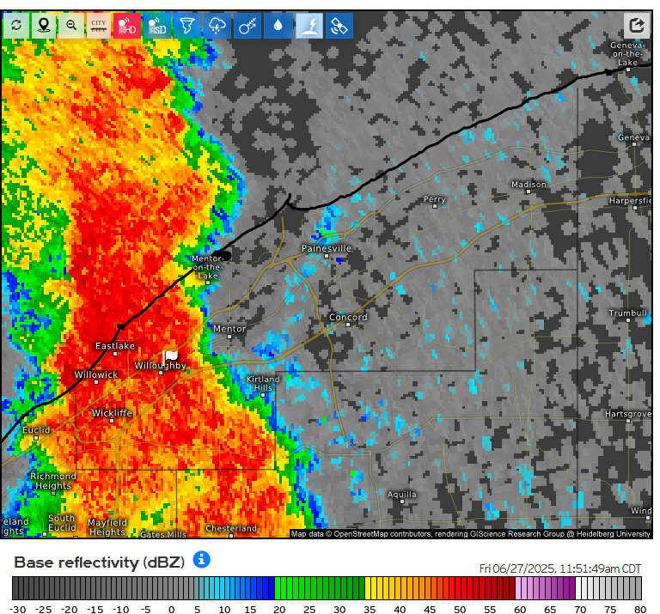
June 27, 2025 Rain Event
Total Rainfall: 1.35”
Peak Intensity: 2.16 in/hr
Duration: 30 min
Classification: 10yr-30min event

Slide 5
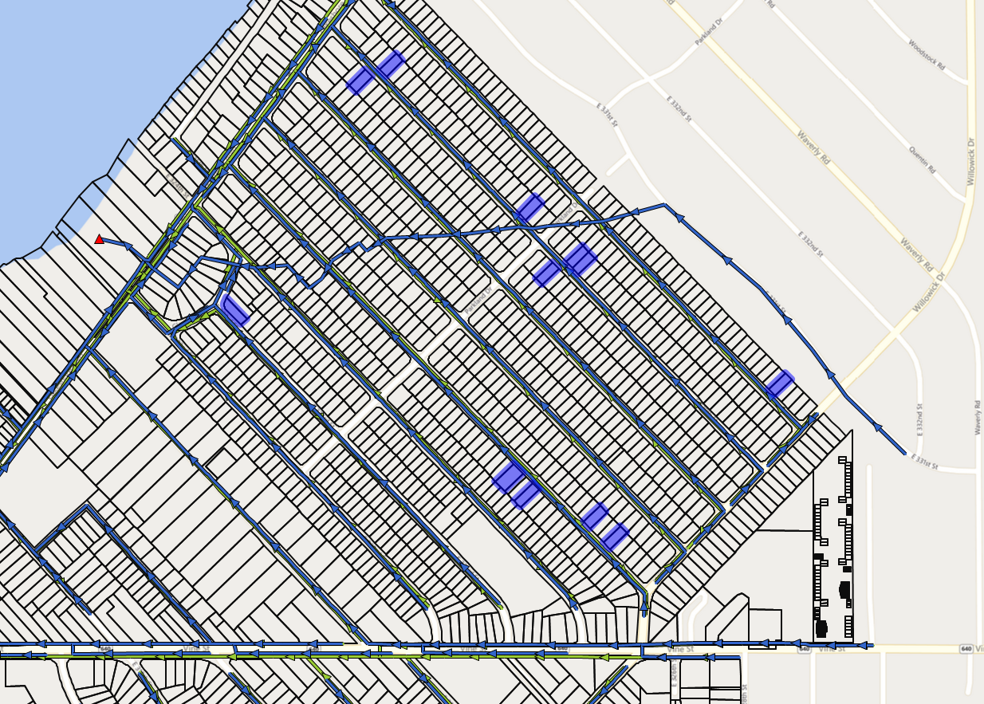
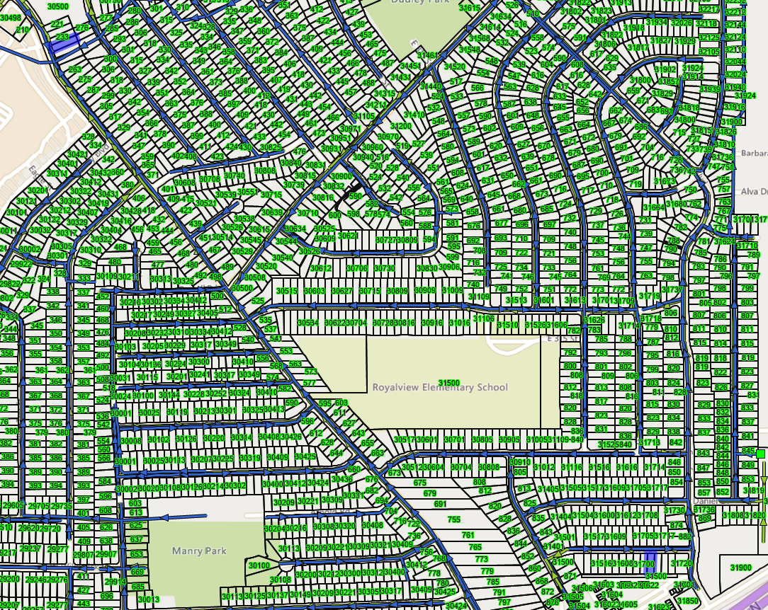
Reported Basement Backup
Thirteen (13) reported
Unknown on specific reason for backups

Slide 6
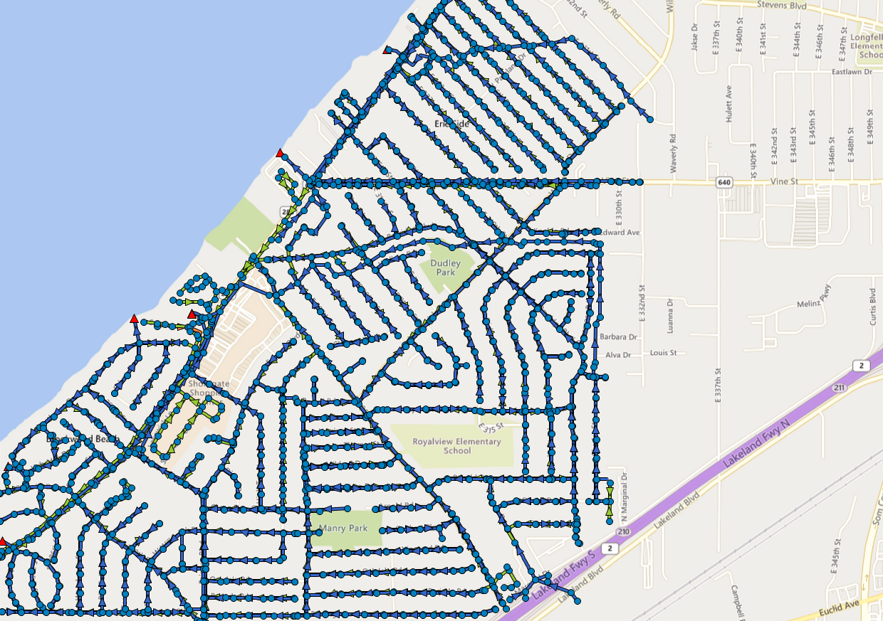
Flow Data
4 Active Meters in the Sanitary
San 001: 32220 Lakeshore Blvd
San 002: 475 Bayridge Blvd
San 003: 287 E. 305th St
S335-TMP: E. 300th St and Barjode Rd

Slide 7
Metered Levels 8/27/2025
Freeboard: Difference in top of flow to the surface of the manhole.
Basement flooding due to elevated flows in the mainline sewers becomes a risk at between 6 to 8 ft and high risk at 6 ft or less
San 001: 3.91’
San 002: N/A (meter went static during event)
Historically comparable storm 8/28/2020: 6.22’
San 003: 9.46’
S335-TMP: 4.15’

Slide 8
Master Plan Review

Slide 9
Master Plan 2016 and Sewer History
Master Plan was completed to better understand the existing separate sewer systems and study options to reduce basement flooding, illicit discharges into Lake Erie, and sanitary sewer overflows (SSOs)
System contains 443,950 total linear feet of storm and sanitary sewer.
Majority of sewers built prior to 1970
Service life of sewers is typically 50 years before replacement or significant rehab is required
Both storm and sanitary sewers were metered modeled, and analyzed for alternatives to improve the level of service relative to wet-weather related issues

Slide 10
Master Plan Alternative Recommendations
Sanitary System
Pilot Study in E. 327th-E 330th Street Area (complete)
Relief Sewers
Willowick Drive
E. 305th Street
Parkland Drive/LSB
Equalization Basin (EQ) Tank or Tunnel
Study and rehab existing local and trunk sewers
Storm System
Replace Lakeland Culvert (complete)
Replace/Rehab Larimar Culvert (in process)
Evaluate and improve Jennison Ditch
Study and rehab aging culverts and trunk sewers

Slide 11
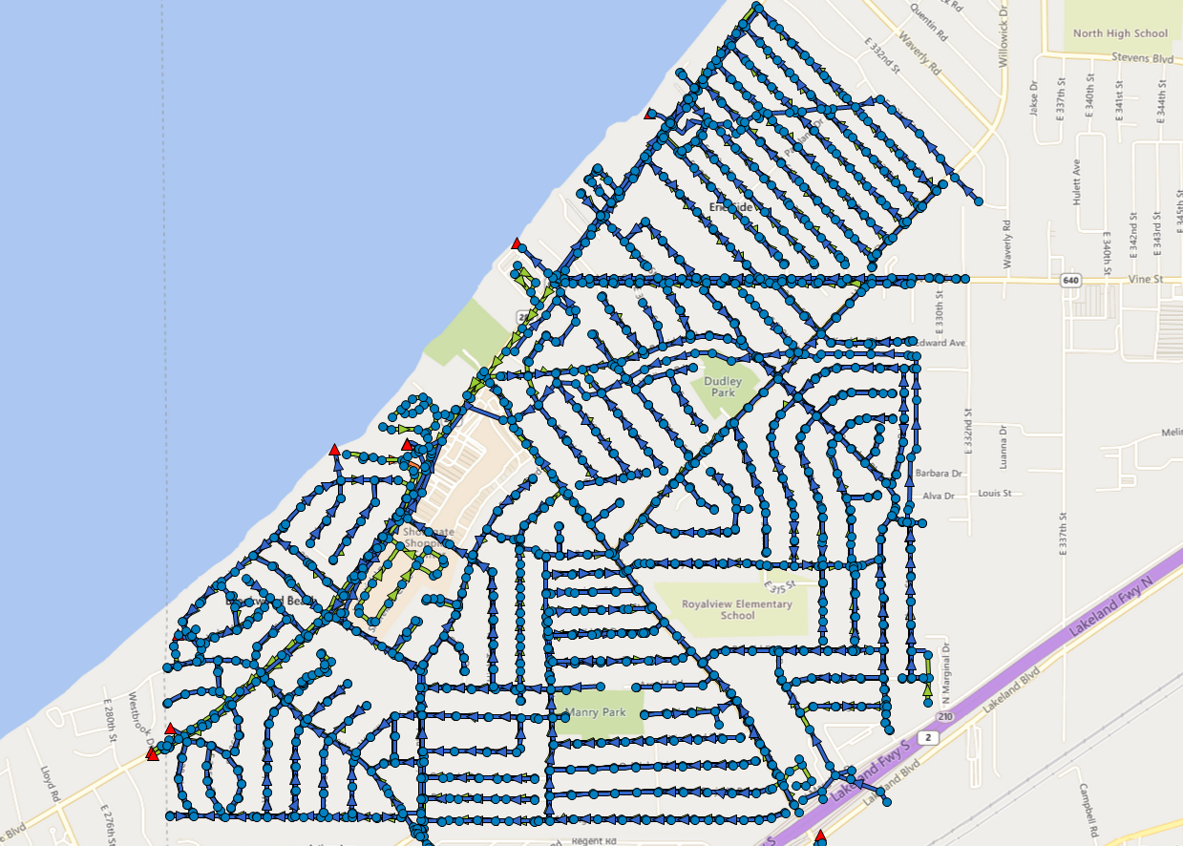
Recent Major Sewer Projects
Projects Last 2015-present
E. 327th Street Sewer Rehab
E. 328th Street Sewer Rehab
E. 329th Street Sewer Rehab
E. 330th Street Sewer Rehab
Fairway Sewer Improvements
Forestgrove Sewer Improvements*
LSB Trunk Sewer West*
Larimar Culvert*
*In-Process

Slide 12
Pilot Study Results
Various combinations of repair and CIPP lining of the sanitary and storm mains and laterals in the E. 327th-E. 330th neighborhood.
Timeframe: 2016-2023
Total Project Cost: $5.5M
Results
Sanitary: 24-32% decrease in volume per inch of rain
Storm: 17-22% increase in volume per inch of rain
Smoke Test Defects: Decrease by approximately 50% from pre-construction on average

Slide 13
Relief Sewers
Willowick Drive
Planning/Engineering: $ 280,000
Construction Cost (w/ CACO) $ 2,300,000
Total w. 20% Contingency $ 3,100,000
E. 305th Street
Planning/Engineering: $ 300,000
Construction Cost (w/ CACO) $ 2,600,000
Total w. 20% Contingency $ 3,480,000
Parkland Drive
Planning/Engineering: $ 600,000
Construction Cost (w/ CACO) $ 7,300,000
Total w. 20% Contingency $ 9,480,000

Slide 14
EQ or Tunnel
Equalization Basin
Planning Study: $ 100,000
Preliminary Engineering: $ 250,000
Final Design/Permitting: $ 1,000,000
Construction Cost: $20,000,000
Total w. 20% Contingency: $25,620,000
Tunnel
Variable depending on multiple factors (needs feasibility study)
Could see 25-40% cost savings depending on location and size compared to EQ

Slide 15
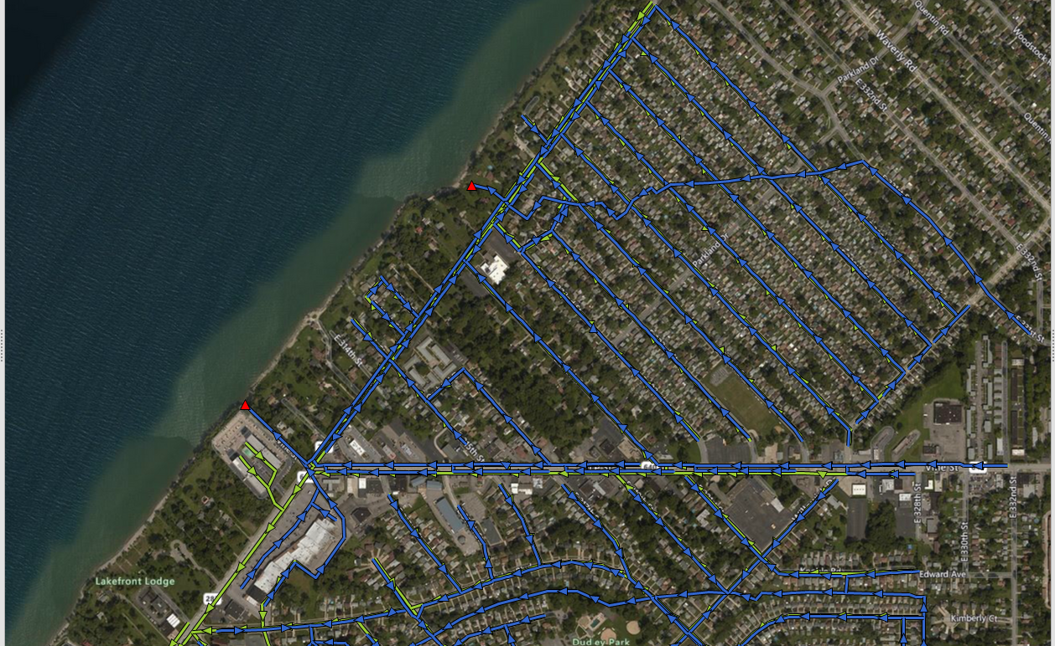
EQ or Tunnel Locations (Tentative)

Slide 16
Funding Options

Slide 17
Funding Sources
WPCLF
Planning, Design, and Construction
Current Standard Rate 21-30 years: 3.7%
$1.6M annual repayment for 30 years for $30M in loan
Principal Forgiveness
Ohio Water Development Authority, Columbus, Ohio, USA
ODOT/NOACA
Congressional Earmarks
Lake County Stormwater Management Fund

